Slide 1
Predicting Weather with Machine Learning:
Intro to ARMA and Random Forest
Emma Ozanich
PhD Candidate,
Scripps Institution of Oceanography

Slide 2
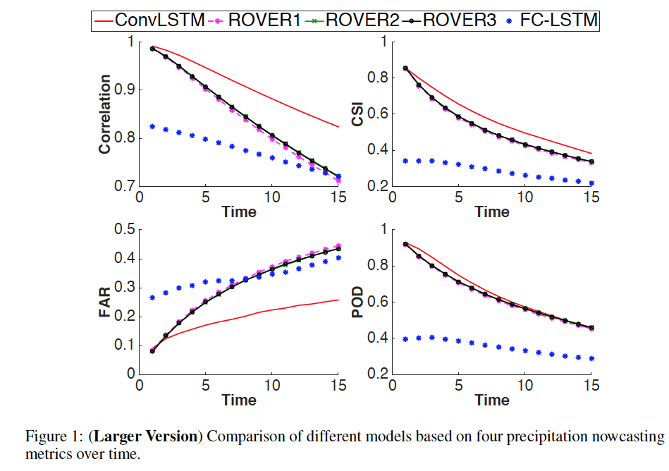
Background
Shi et al NIPS 2015 –
Predicting rain at different time lags
Shows convolutional lstm vs nowcast models vs fully-connected lstm
Used radar echo (image) inputs
Hong Kong, 2011-2013,
240 frames/day
Selected top 97 rainy days
Note: <10% of data used!
Preprocessing: k-means clustering to denoise
ConvLSTM has better performance and lower false alarm (lower left)
CSI: hits/(hits+misses+false) FAR: false/(hits+false) POD: hits/(hits+misses)
false = false alarm
Notes:
http://papers.nips.cc/paper/5955-convolutional-lstm-network-a-machine-learning-approach-for-precipitation-nowcasting.pdf
https://ieeexplore.ieee.org/stamp/stamp.jsp?tp
https://journals.ametsoc.org/doi/full/10.1175/JCLI-D-13-00713.1
https://www.esrl.noaa.gov/psd/gcos_wgsp/Gridded/data.hadslp2.html

Slide 3
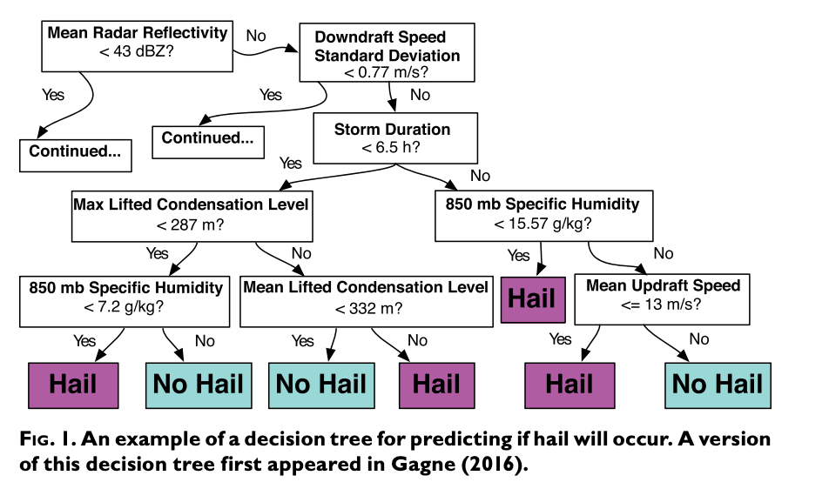
Background
McGovern et al 2017 BAM –
Decision trees used in meteorology since mid-1960s
Predicting rain at different time lags
McGovern et al 2017, Bull. Amer. Meteor. Soc. 98:10, p. 2073-2090.
Notes:
http://papers.nips.cc/paper/5955-convolutional-lstm-network-a-machine-learning-approach-for-precipitation-nowcasting.pdf
https://ieeexplore.ieee.org/stamp/stamp.jsp?tp
https://journals.ametsoc.org/doi/full/10.1175/JCLI-D-13-00713.1
https://www.esrl.noaa.gov/psd/gcos_wgsp/Gridded/data.hadslp2.html
https://journals.ametsoc.org/doi/pdf/10.1175/JCLI-D-13-00713.1

Slide 4
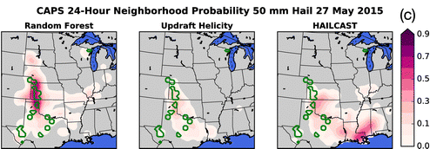
Background
McGovern et al 2017 BAM –
Green contours = hail occurred (truth)
Physics based method: Convection-allowing model (CAM)
Doesn’t directly predict hail
Random forest predicts hail size (Γ) distribution based on weather
HAILCAST = diagnostic measure based on CAMs
Updraft Helicity = surrogate variable from CAM
McGovern et al 2017, Bull. Amer. Meteor. Soc. 98:10, p. 2073-2090.
Notes:
http://papers.nips.cc/paper/5955-convolutional-lstm-network-a-machine-learning-approach-for-precipitation-nowcasting.pdf
https://ieeexplore.ieee.org/stamp/stamp.jsp?tp
https://journals.ametsoc.org/doi/full/10.1175/JCLI-D-13-00713.1
https://www.esrl.noaa.gov/psd/gcos_wgsp/Gridded/data.hadslp2.html
https://journals.ametsoc.org/doi/pdf/10.1175/JCLI-D-13-00713.1

Slide 5
Decision Trees
Algorithm made up of conditional control statements
Notes:
NOAA: national oceanic and atmospheric administration
CPC: Climate Prediction Center – NOAA
NCEI: National Centers for Environmental Information – NOAA
NASA: National Aeronautics and Space Administration
IMOS: Integrated Marine Observing System
USGS: United States Geological Survey
ECMWF: European Centre for Medium-Range Weather Forecasts

Slide 6
Decision Trees
McGovern et al 2017 BAM –
Decision trees used in meteorology since mid-1960s
McGovern et al 2017, Bull. Amer. Meteor. Soc. 98:10, p. 2073-2090.

Slide 7
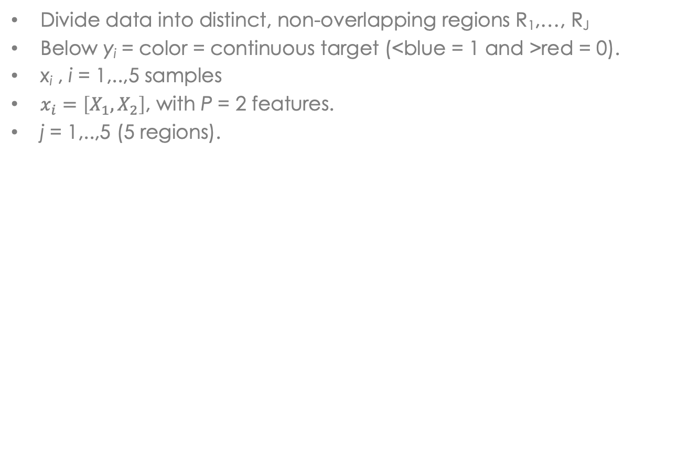
Regression Tree
Divide data into distinct, non-overlapping regions R₁,…, R_{J}
Below y_{i} = color = continuous target (<blue = 1 and >red = 0).
x_{i} , i = 1,..,5 samples
$x_{i}=\left[X_{1},X_{2}\right]$, with P = 2 features.
j = 1,..,5 (5 regions).
Hastie et al 2017, Chap. 9 p 307.

Slide 8
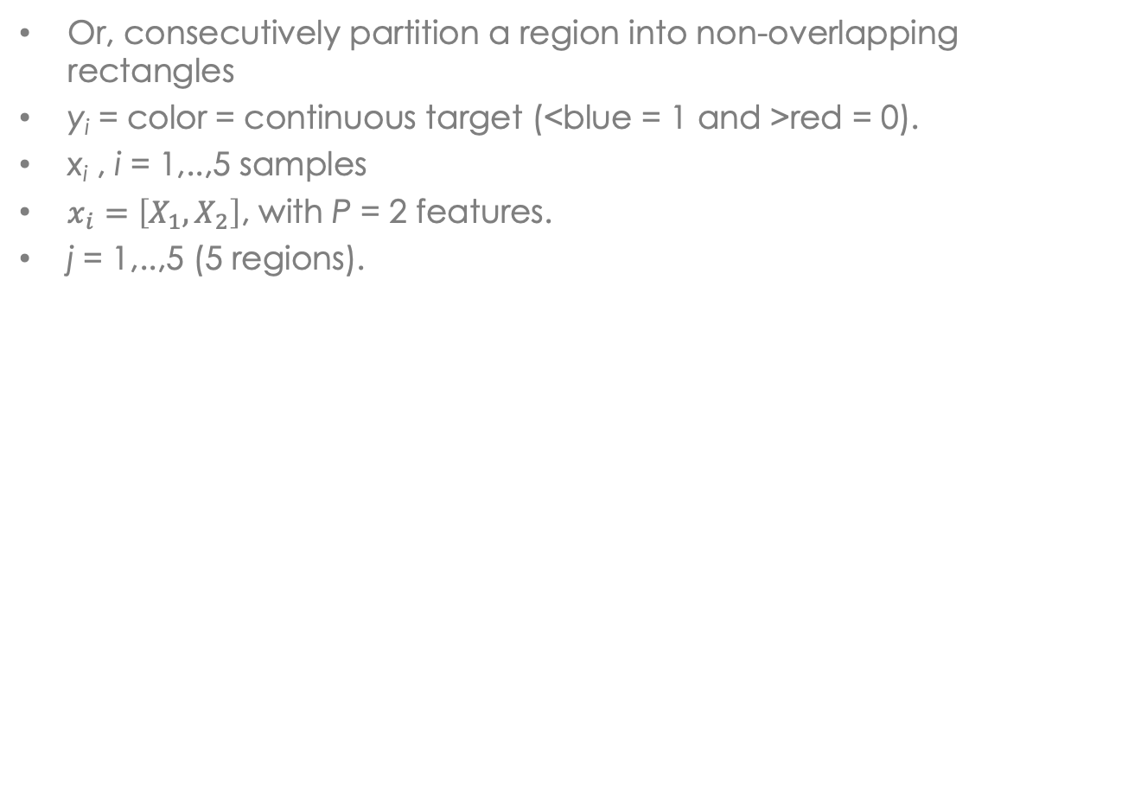
Tree-building
Or, consecutively partition a region into non-overlapping rectangles
y_{i} = color = continuous target (<blue = 1 and >red = 0).
x_{i} , i = 1,..,5 samples
$x_{i}=\left[X_{1},X_{2}\right]$, with P = 2 features.
j = 1,..,5 (5 regions).
Hastie et al 2017, Chap. 9 p 307.

Slide 9
Regression Tree
How to optimize a regression tree?
Randomly select t₁
Assign region labels:
Example-
t₁
t₁
₁
t₁
t₁
, j = 1
R₂
₁
₂
₂

Slide 10
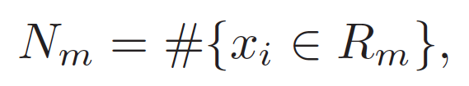
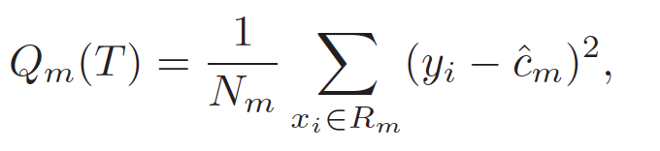
Regression Tree
Compute the cost of the tree, Q_{m}(T),
Minimize Q_{m}(T) by changing t₁
₁
R₂
₂

Slide 11
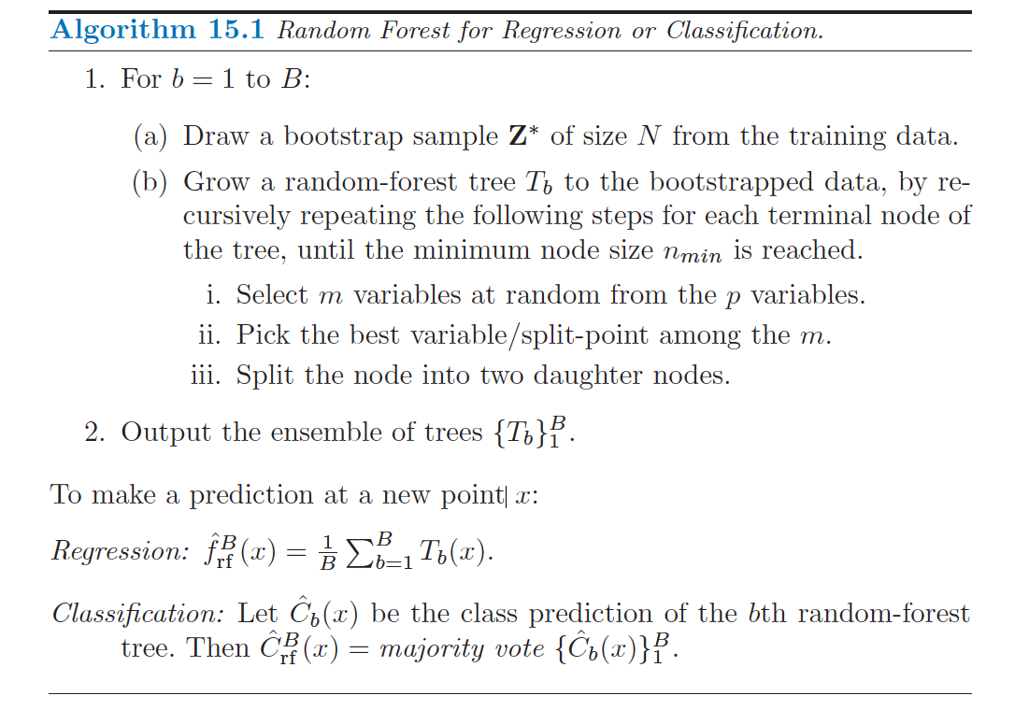
Regression Tree
Algorithm to build tree T_{b}
In our simple case, m = 1 and p = 2
Daughter nodes are equivalent to regions
1.
2.
3.
R₂

Slide 12
Bootstrap samples
Select a subset of the total samples, (x*_{i} ,y*_{i}), i = 1,…,N
Draw samples uniformly at random with replacement
Example: If I = 5 originally, we could choose N = 2
Samples are drawn assuming equal probability:
If x_{i}, y_{i} is drawn more often, it is more likely
(X,Y) are the expectations of the underlying distributions

Slide 13
Random Forest
Example of binary classification tree from Hastie et al 2017
Orange: trained on all data
Green: trained from different bootstrap samples
Then, average the (green) trees
Hastie et al 2017, Chap. 8 p. 284

Slide 14
Random Forest
Bootstrap + bagging => more robust RF on future test data
Train each tree T_{b} on bootstrap sampling
Hastie et al 2017, Chap. 15 p. 588

Slide 15
Timeseries (TS)
Timeseries: one or more variables sampled in the same location at successive time steps

Slide 16
ARMA
Autoregressive moving-average :
(weakly) stationary stochastic process
Polynomials model process and errors as polynomial of prior values
Autogressive (order p)
Linear model of past (lagged) and future values
p lags
φ_{i} are (weights) parameters
c is constant
ε_{t} is white noise (WGN)
Note, for stationary processes, |φ_{i}|< 1.
Moving-average (order q)
Linear model of past errors
q lags
Below, assume <X_{t}>=0 (expectation is 0)

Slide 17
ARMA
Autoregressive moving-average :
(weakly) stationary stochastic process
Linear model of prior values = expected value term + error term + WGN
ARMA: AR(p) + MA(q)

Slide 18
Data retrieval
Just a few public data sources for physical sciences…
NOAA:
Reanalysis/model data, research cruises, station observations, gridded data products, atmospheric & ocean indices timeseries, heat budgets, satellite imagery
NASA:
EOSDIS, gridded data products (atmospheric), satellite imagery, reanalysis/model data, meteorological stations, DAAC’s in US
IMOS:
ocean observing hosted by Australian Ocean Data Network
USGS Earthquake Archives
CPC/NCEI:
gridded and raw meteorological and oceanographic
ECMWF
global-scale weather forecasts and assimilated data
…
Possible data formats:
CSV
NetCDF
HDF5/HDF-EOS
Binary
JPEG/PNG
ASCII text
……
Notes:
NOAA: national oceanic and atmospheric administration
CPC: Climate Prediction Center – NOAA
NCEI: National Centers for Environmental Information – NOAA
NASA: National Aeronautics and Space Administration
IMOS: Integrated Marine Observing System
USGS: United States Geological Survey
ECMWF: European Centre for Medium-Range Weather Forecasts

Slide 19
Basic data cleaning
“[ML for physical sciences] is 80% cleaning and 20% models” ~ paraphrased, Dr. Gerstoft
Basic cleaning for NOAA GSOD to HW – necessary
Remove unwanted variables (big data is slow)
Replaced “9999” filler values with NaN
Converted strings to floats (i.e. for wind speed)
Created a DateTime index
Physical data needs cleaning, reorganizing
Quality-controlled data still causes bugs
Application-specific

Slide 20
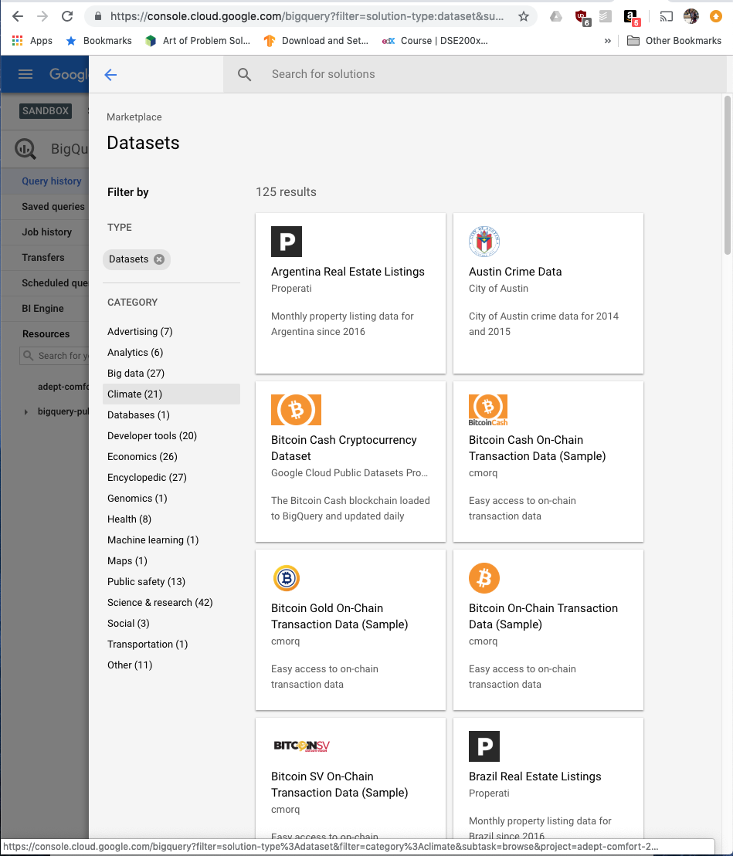
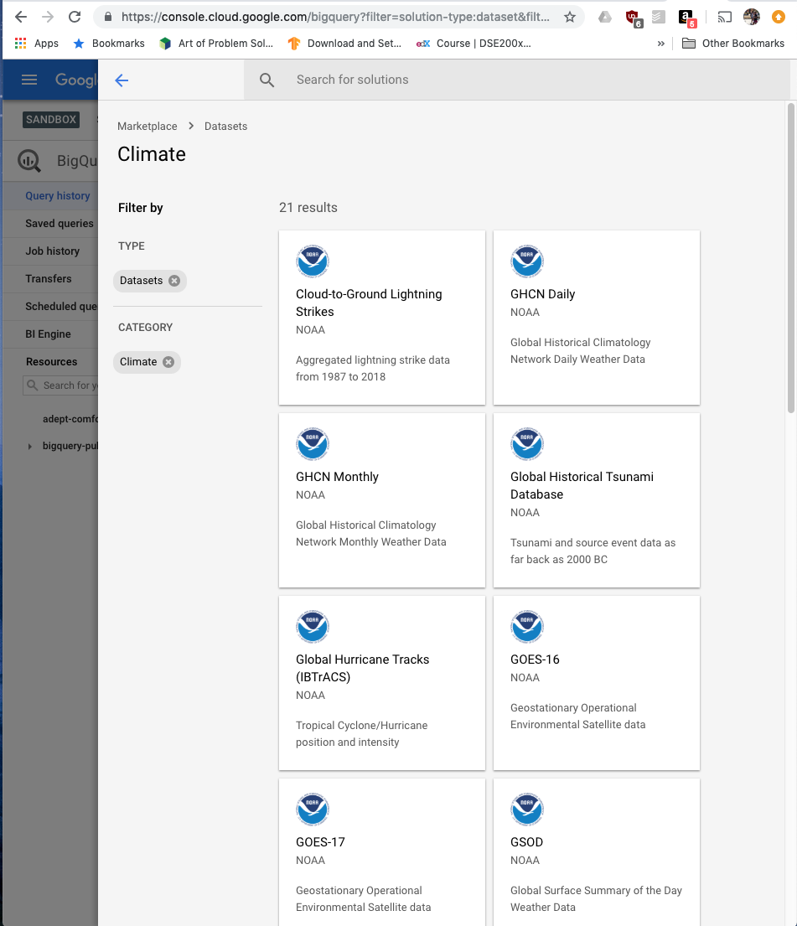
Data for HW
BigQuery:
Open-source database hosted by Google
Must have Google account
1 TB data free/ month
NOAA GSOD dataset

Slide 21
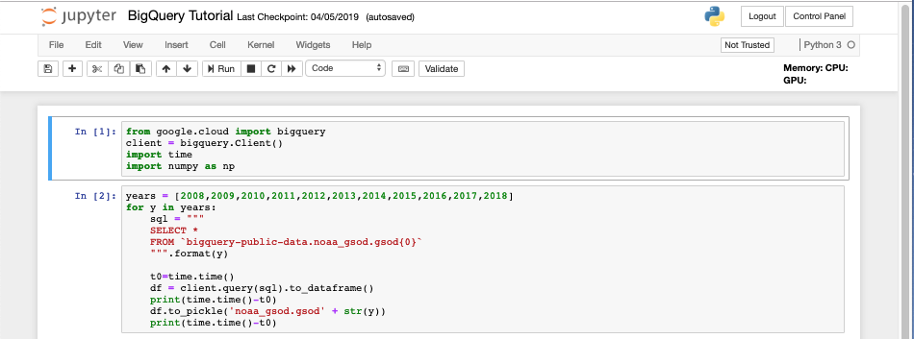
Data for HW
How to get BigQuery data?
bigquery package in Jupyter Notebook (SQL server)
More complex queries may include dataframe joins, aggregations, or subsetting
Yearly datasets
Simple SQL query
Pickle the DF
Query client and convert to Pandas DF

Slide 22
Tutorial Notebook
Open “In-Class Tutorial”
We will do:
Load preprocessed data
Define timeseries index
Look at data
Visualize station
Detrend data
Smooth data
Try ARMA model

Slide 23
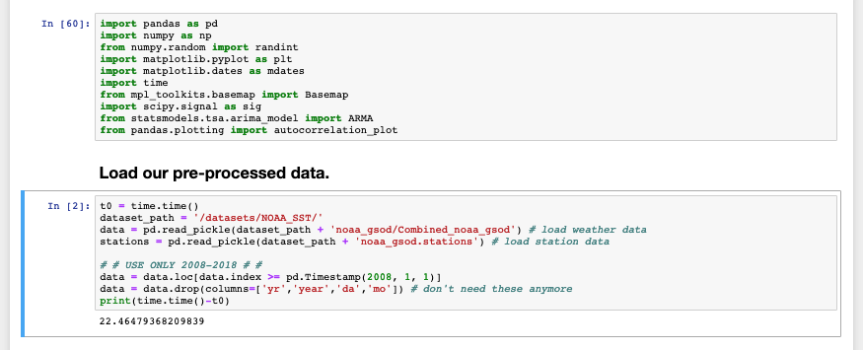
Tutorial Notebook
Load packages, (pre-processed) data with Pandas
import packages
load data
find where data is after 2008

Slide 24
Timeseries processing
We may be missing data, but that’s ok for now
Replace with neighbor data, smooth, fill with mean
missing data

Slide 25
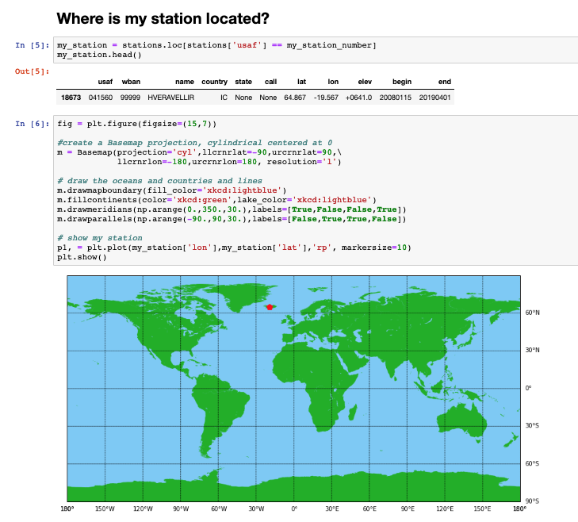
Tutorial Notebook
Basemap is handy but some problems if running on your laptop

Slide 26
Timeseries processing
Remove mean (slope=0) or linear (slope ≠ 0)? (linear)
What can we learn from trend?

Slide 27
Timeseries processing
Smoothing: median filter

Slide 28
Tutorial Notebook
Shortened timeseries – Y2018 (final 10%)
ARMA most effective predicting one step at a time

Slide 29
Tutorial Notebook
Is ARMA a machine learning technique? (I think so..)
Filtering method (like Kalman filter)
Data-driven
Maximum likelihood
Conclusion: statistics-based

Slide 30
Tutorial Notebook
Autocorrelation:
A statistical method to find temporal (or spatial) relations in data
When can reject the null hypothesis that the data is statistically similar?
E.g. How many time steps before the data is decorrelated
~40 lags

Slide 31
Tutorial Notebook
Median filter increases decorrelation scale
By averaging neighbor samples
Raw series is more random
Use raw timeseries
~3 lags

Slide 32
Tutorial Notebook
ARMA algorithm:
Train on all previous data
Predict one time step
Add next value to training data
Repeat

Slide 33
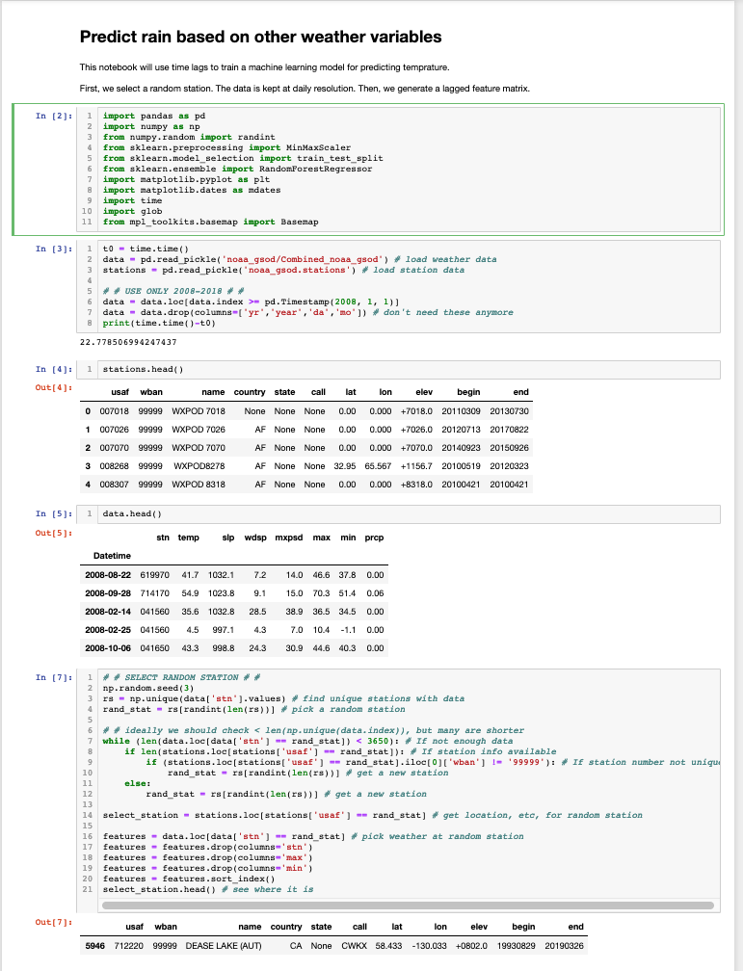
Homework
How to load and preview data with Pandas
import packages
load data
find where data is after 2008

Slide 34
Homework
How to load and preview data with Pandas
corresponding recording station
column of all temperature entries

Slide 35
Homework
Randomly select a station
Check if the station has enough data
May reduce “3650” to lower number, i.e. 1000, but be aware you may have nans in data – just look at it!
select random station
find data that matches station
remove data related to temperature

Slide 36
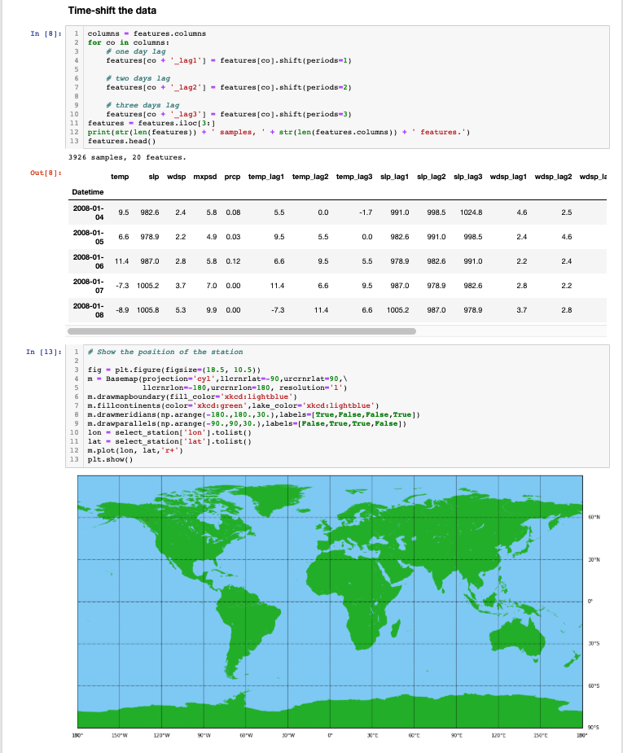
Homework
Manually time-delay data
Pandas “shift()”
Pandas shift()
remove first 3 entries

Slide 37
Homework
(Map is supposed to show red “X” for station)
I can barely see it!!

Slide 38
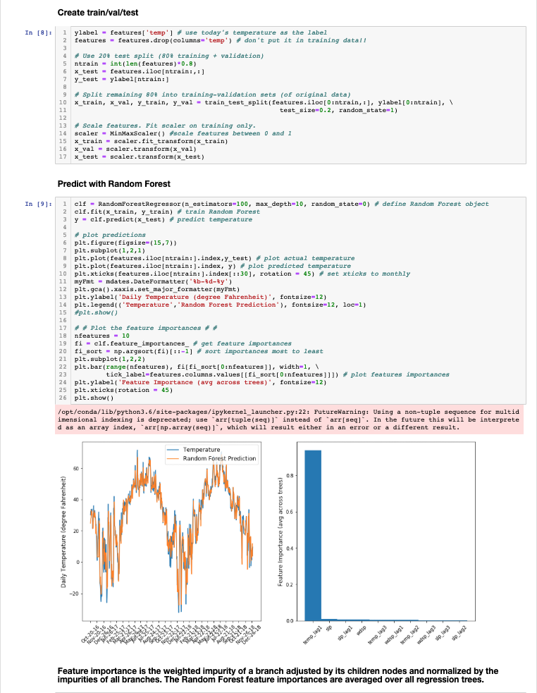
Homework
Snapshots from “timeseries_prediction_Temp.ipynb”
training label = temperature
split data into train/test with the help of Sklearn
scaling features improves learning

Slide 39
Homework
Random forest model in a couple lines
You may want to write a “plot.py” function
Define, train, and predict with random forest
plotting true and predicted temperature
look at feature importances

Slide 40
Homework
Congratulations!
We showed that tomorrow’s temperature is usually similar to today’s (at this Canada station)
unsurprising result:
validates intuition

Slide 41
Extras
Notes:
http://papers.nips.cc/paper/5955-convolutional-lstm-network-a-machine-learning-approach-for-precipitation-nowcasting.pdf
https://ieeexplore.ieee.org/stamp/stamp.jsp?tp
https://journals.ametsoc.org/doi/full/10.1175/JCLI-D-13-00713.1
https://www.esrl.noaa.gov/psd/gcos_wgsp/Gridded/data.hadslp2.html
https://journals.ametsoc.org/doi/pdf/10.1175/JCLI-D-13-00713.1

Slide 42
Other pubs on ML for weather/climate
Weather (short-term)
Precipitation prediction with Convolutional LSTM - Shi et al NIPS 2015
Short-term wind forecast using ANN v ARIMA – Chen et al 2011 Asia-Pacific Power and Energy Engineering Conf.
Hail and precipitation prediction– McGovern et al 2017 BAMS
…..
Climate cycles (mid-term)
El Nino, SRNN – Liess et al 2014 Journal of Climate
Notes:
http://papers.nips.cc/paper/5955-convolutional-lstm-network-a-machine-learning-approach-for-precipitation-nowcasting.pdf
https://ieeexplore.ieee.org/stamp/stamp.jsp?tp
https://journals.ametsoc.org/doi/full/10.1175/JCLI-D-13-00713.1
https://www.esrl.noaa.gov/psd/gcos_wgsp/Gridded/data.hadslp2.html
https://journals.ametsoc.org/doi/pdf/10.1175/JCLI-D-13-00713.1

